Slide 1

Triangle Counting
Yuval Alfassi

Slide 2

Triangle Counting – Static Centrelized
$O\left(m^{1.5}\right) −edge itarator$
$O\left(m∙d_{max}\right)−edge iterator$
$O\left(n∙d_{max}^{2}\right) −node iterator$
$O\left(m^{1.41}\right) −Impractical$
$Approximations$

Slide 3
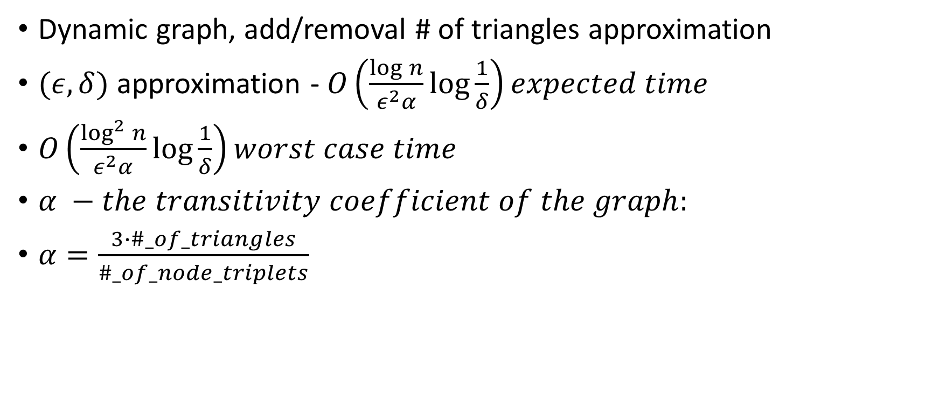
Incremental – Dynamic central approximation
Dynamic graph, add/removal # of triangles approximation
$(ε,δ)$ approximation - $O\left(\frac{\log{n}}{ε^{2}α}\log{\frac{1}{δ}}\right)expected time$
$O\left(\frac{\log^{2}{n}}{ε^{2}α}\log{\frac{1}{δ}}\right)worst case time$
$α −the transitivity coefficient of the graph:$
$α=\frac{3∙\#_of_triangles}{\#_of_node_triplets}$

Slide 4

Triangle Counting – Dynamic Centrelized
$O\left(d_{max}\right) per update, assumes O\left(1\right) edge existance checking$
$O\left(1\right) edge existance:$
$Adjacent Matrix, O\left(n^{2}\right) space$
$Perfect Hashing, makes the complexity probabalistic$

Slide 5

Triangle Counting – Dynamic + Centrelized + Persistent
$O\left(d_{max}∙log⁡(n)\right) per update$
$Infinite number of vertices −Automatic vertices addition$
$Fully functional −supports persistency(!)$

Slide 6
Performance Results

Slide 7
Persistensy explained

